Slide 1

Utah Bears Baseball
Website Storyboards

Slide 2
PERONAS
DISTRIBUTORS, CONSUMERS, AND BOTH

Slide 3

PERSONAS – DATA DISTRIBUTORS
Marty Manager – Marty is a manager for the Utah Bears. Marty works 50+ hour weeks at his day job and doesn’t necessarily have time to communicate every change that happens individually to his team members (all 22 of them). He is looking for a means to streamline his interaction with his players so that he can make an announcement once for everyone.
Marty Manager is 35 years old.
He works a day job in an office 5-6 days each week.
He is married and has a child.
He has been on the team for 12 seasons, and managed for the last 8.

Slide 4

PERSONAS – DATA DISTRIBUTORS
Paul Player – Paul is a player for the Utah Bears. He doesn’t get involved with managing the team but contacts the manger and other coaches regularly for updates on games and outside events. Paul is young enough to be fairly tech savvy, but doesn’t regularly interact with platforms like Google Hangouts, Discord, or other chat methods. This means most of his communication with the league, team, and coaching staff is done either via text or email. Paul would love to be able to view information JIT (Just in Time) through a single point of contact, rather than awaiting communication for the league or coaching staff.
Paul Player is 22 years old
He works a construction job 5 days each week
He is single.
He lives with his parents.
He has been with the team for 4 seasons.

Slide 5


PERSONAS – DATA CONSUMERS
Perry Player – Parry is a player for the Utah Bears. He is very similar to Paul with one exception. Perry is very into modern communication on both his desktop and mobile devices. He is comfortable with means of communication like Slack, Hangouts, etc. He s frustrated that players like Paul make communication hard and would except any solution that just gets people to the batting cage on time.
Perry Player is 30 years old
He owns a small business selling and repairing motorcycles
He lives in an apartment with friends.
He has been with the team for 2 seasons
Perry played Triple A baseball
Frank Fan – Frank is a fan and family member of Paul Player. Frank wants to support Paul in his pursuit of baseball, but because of the current communication model, he doesn’t know the schedule or Paul’s stats. This limits his ability to support his family member in the way that he would like. Frank doesn’t expect the team coaching staff to loop him into conversations, and Paul just isn’t the type of person to do so. He would love a place he could look up the schedule of events, or even how Paul did in a game so that he can support his family how he wishes.
Frank Fan is 55 years old.
He is Paul Player’s father.
He works full time at a car dealership in the service department.
He is married and has 3 children.
He has coached Paul since childhood.

Slide 6
PROBLEMS AND STORYBOARDS
WHAT ARE WE SOLVING?

Slide 7

PROBLEMS
MVP Problems
NO SINGLE SOURCE OF TRUTH
COMMUNICATION IS CONSTANT AND TEDIOUS WITH ALL MEMBERS OF THE TEAM
FANS AND FAMILY OF THE TEAM ARE RELIANT ON A GAME OF ‘TELEPHONE’
Stretch Problems
STATS ARE NOT LOCATED IN A SINGLE PLACE
STATS ARE HARD TO COMMUNICATE, COMPARE, AND DISCUSS
STATS ARE ONLY AVAILABLE VIA EMAILED DOCUMENT

Slide 8
MVP Storyboards

Slide 9
PROBLEM #1 – NO SINGLE SOURCE OF TRUTH
WHICH PERSONAS ARE AFFECTED?
DISTRIBUTORS – HAVE TO REPEAT THE SAME MESSAGE OVER AND OVER RATHER THAN ONE AND DONE, LOTS OF OVERHEAD
DISTRIBUTORS AND CONSUMERS – NEED THE INFO THEMSELVES, AND THEN HAVE TO PASS IT ON WITH ACCURACY AND INTENT. THERE ARE OFTEN LAPSES IN BOTH.
CONSUMERS – NEED THE INFO, AND CANNOT GET IT WHEN THEY NEED IT

Slide 10
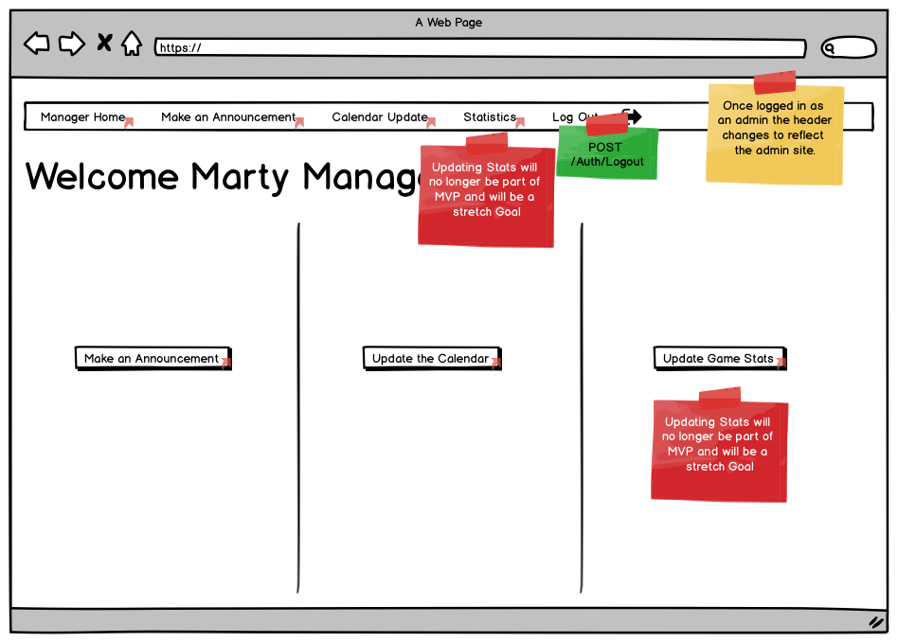
PROBLEM #1 – NO SINGLE SOURCE OF TRUTH STORYBOARDS
THE SOLUTION BEGINS BY ALLOWING MANAGER MARTY TO UPDATE ALL INFORMATION IN ONE PLACE

Slide 11
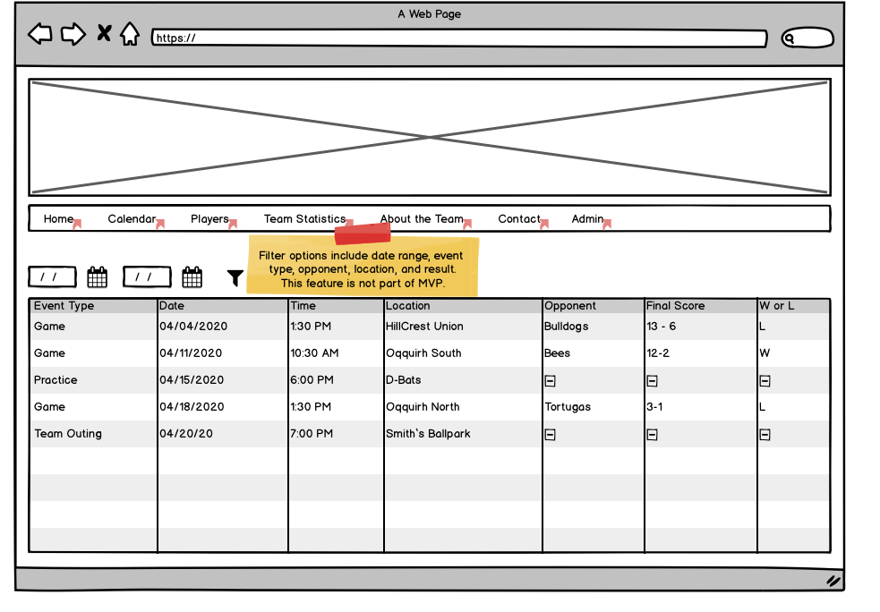
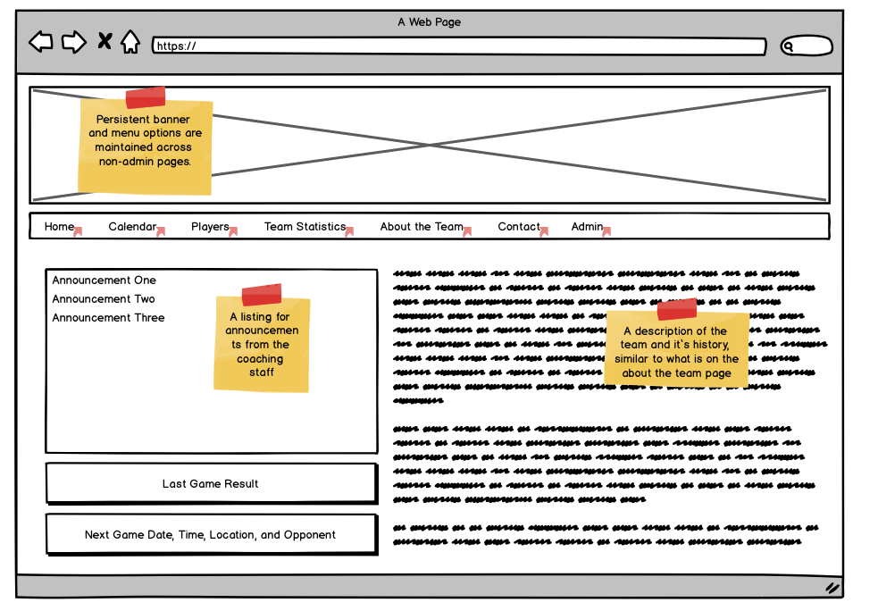
PROBLEM #1 – NO SINGLE SOURCE OF TRUTH STORYBOARDS
ONCE MARTY HAS ENTERED THE INFO PAUL IS CONVERTED TO A CONSUMER ONLY – THE BURDEN IS OFF HIM TO SHARE WITH FRANK, AND ALL CONSUMERS CAN NOW GET WHAT THEY NEED WHEN THEY NEED IT WITHOUT ERRORS FROM HANDING OFF ONE TO ANOTHER.

Slide 12

PROBLEMS #2 & 3 - COMMUNICATION IS CONSTANT AND TEDIOUS WITH ALL MEMBERS OF THE TEAM | FANS AND FAMILY OF THE TEAM ARE RELIANT ON A GAME OF ‘TELEPHONE’
PERSONAS ARE AFFECTED IN MUCH THE SAME WAY AS PROBLEM #1
WHICH PERSONAS ARE AFFECTED?
DISTRIBUTORS – HAVE TO REPEAT THE SAME MESSAGE OVER AND OVER RATHER THAN ONE AND DONE, LOTS OF OVERHEAD
DISTRIBUTORS AND CONSUMERS – NEED THE INFO THEMSELVES, AND THEN HAVE TO PASS IT ON WITH ACCURACY AND INTENT
CONSUMERS – NEED THE INFO, AND CANNOT GET IT WHEN THEY NEED IT

Slide 13
PROBLEM #2 – COMMUNICATION IS CONSTANT AND TEDIOUS WITH ALL MEMBERS OF THE TEAM STORYBOARDS
JUST AS IN PROBLEM NUMBER 1, ONCE MARTY ENTERS THE DATA, THE TEAM HAS A POINT OF CONTACT THEY CAN REFERENCE AT ANY TIME. COMMUNICATION BECOMES A ONE TIME ASYNCHRONOUS EVENT, RATHER THAN A CONSTANT BACK AND FORTH BETWEEN THE MANAGER AND HIS 21 PLAYERS.

Slide 14
PROBLEM #3 – FANS AND FAMILY OF THE TEAM ARE RELIANT ON A GAME OF ‘TELEPHONE’ STORYBOARDS
AS MENTIONED IN THE PERSONA FOR FRANK FAN, HE IS BEHOLDEN TO HIS SON, PAUL PLAYER FOR INFORMATION ON GAMES.
WHAT WE SEE WITH THE SINGLE SOURCE OF TRUTH CREATED, IS THAT THIS PROBLEM FOR FRANK DISAPPEARS. HE IS NOW ABLE TO ACCESS THE INFO HE NEEDS WITHOUT A MIDDLEMAN, MOVING HIM ONE STEP CLOSER TO THE SOURCE, AND ELIMINATING THE ‘TELEPHONE’ GAME.

Slide 15
Stretch Goal Storyboards

Slide 16
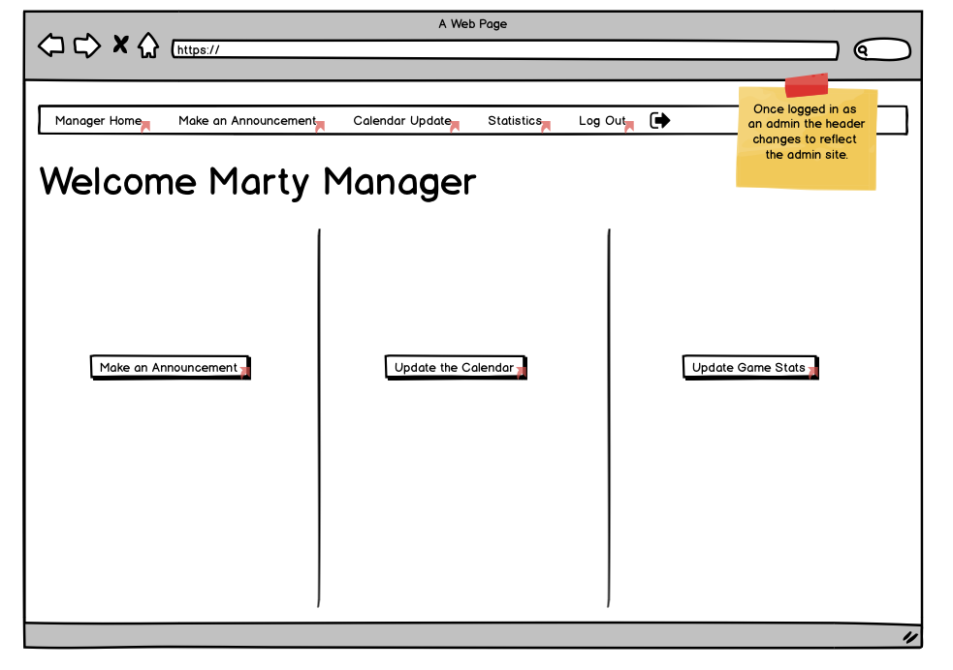
PROBLEM #1 – NO SINGLE SOURCE OF TRUTH STORYBOARDS
THE SOLUTION BEGINS BY ALLOWING MANAGER MARTY TO UPDATE ALL INFORMATION IN ONE PLACE

Slide 17
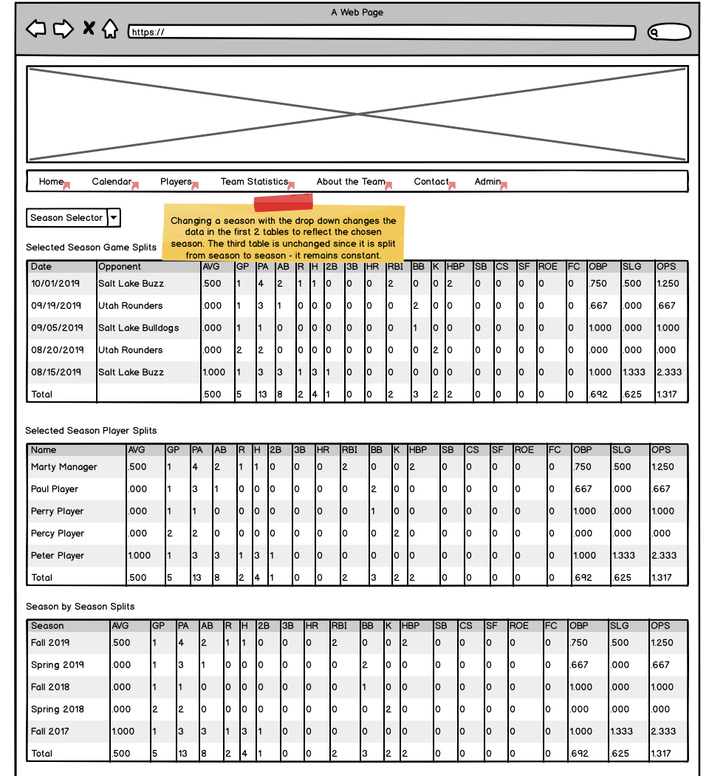
PROBLEM #1 – NO SINGLE SOURCE OF TRUTH STORYBOARDS
ONCE MARTY HAS ENTERED THE INFO PAUL IS CONVERTED TO A CONSUMER ONLY – THE BURDEN IS OFF HIM TO SHARE WITH FRANK, AND ALL CONSUMERS CAN NOW GET WHAT THEY NEED WHEN THEY NEED IT WITHOUT ERRORS FROM HANDING OFF ONE TO ANOTHER.

Slide 18
PROBLEMS #2 & 3 - COMMUNICATION IS CONSTANT AND TEDIOUS WITH ALL MEMBERS OF THE TEAM | FANS AND FAMILY OF THE TEAM ARE RELIANT ON A GAME OF ‘TELEPHONE’
PERSONAS ARE AFFECTED IN MUCH THE SAME WAY AS PROBLEM #1
WHICH PERSONAS ARE AFFECTED?
DISTRIBUTORS – HAVE TO REPEAT THE SAME MESSAGE OVER AND OVER RATHER THAN ONE AND DONE, LOTS OF OVERHEAD
DISTRIBUTORS AND CONSUMERS – NEED THE INFO THEMSELVES, AND THEN HAVE TO PASS IT ON WITH ACCURACY AND INTENT
CONSUMERS – NEED THE INFO, AND CANNOT GET IT WHEN THEY NEED IT

Slide 19
PROBLEM #2 – COMMUNICATION IS CONSTANT AND TEDIOUS WITH ALL MEMBERS OF THE TEAM STORYBOARDS
JUST AS IN PROBLEM NUMBER 1, ONCE MARTY ENTERS THE DATA, THE TEAM HAS A POINT OF CONTACT THEY CAN REFERENCE AT ANY TIME. COMMUNICATION BECOMES A ONE TIME ASYNCHRONOUS EVENT, RATHER THAN A CONSTANT BACK AND FORTH BETWEEN THE MANAGER AND HIS 21 PLAYERS.

Slide 20
PROBLEM #3 – FANS AND FAMILY OF THE TEAM ARE RELIANT ON A GAME OF ‘TELEPHONE’ STORYBOARDS
AS MENTIONED IN THE PERSONA FOR FRANK FAN, HE IS BEHOLDEN TO HIS SON, PAUL PLAYER FOR INFORMATION ON GAMES AND STATS.
WHAT WE SEE WITH THE SINGLE SOURCE OF TRUTH CREATED, IS THAT THIS PROBLEM FOR FRANK DISAPPEARS. HE IS NOW ABLE TO ACCESS THE INFO HE NEEDS WITHOUT A MIDDLE MAN, MOVING HIM ONE STEP CLOSER TO THE SOURCE, AND ELIMINATING THE ‘TELEPHONE’ GAME.

Slide 21
PROBLEM #4 ,5, & 6 – STATS ARE NOT LOCATED IN ONE PLACE | STATS ARE HARD TO COMMUNICATE, COMPARE, AND DISCUSS | STATS ARE ONLY AVAILABLE VIA EMAILED DOCUMENT
RIGHT NOW STATS ONLY EXIST IN THE PHYSICAL SCORE BOOKS TURNED INTO THE LEAGUE, OR AT THE MANAGERS DISCRETION TO TABULATE AND DISTRIBUTE VIA EMAIL.
THIS IS INEFFICIENT AND CAUSES PROBLEMS. IF THERE ARE EDITS, A PHYSICAL COPY FLOATING IN EMAIL WON’T BE UPDATED, AND IT BECOMES NEAR IMPOSSIBLE FOR PLAYERS AND FANS TO VIEW AND DISCUSS.
WHICH PERSONAS ARE AFFECTED?
DISTRIBUTORS – HAVE TO SEND STATS AND CORRECTIONS OVER EMAIL, MANAGING MULTIPLE ‘PHYSICAL COPIES’ OF THE SAME DATA
DISTRIBUTORS AND CONSUMERS – NEED THE INFO THEMSELVES, AND THEN HAVE TO PASS IT ON WITH ACCURACY AND INTENT
CONSUMERS – WANT THE DATA. THEY WANT HISTORICAL DATA FOR COMPARISON WHICH SIMPLY DOESN’T EXIST
THE DATA IS HARD TO CONSUME BECAUSE IT IS IN A SPREADSHEET

Slide 22
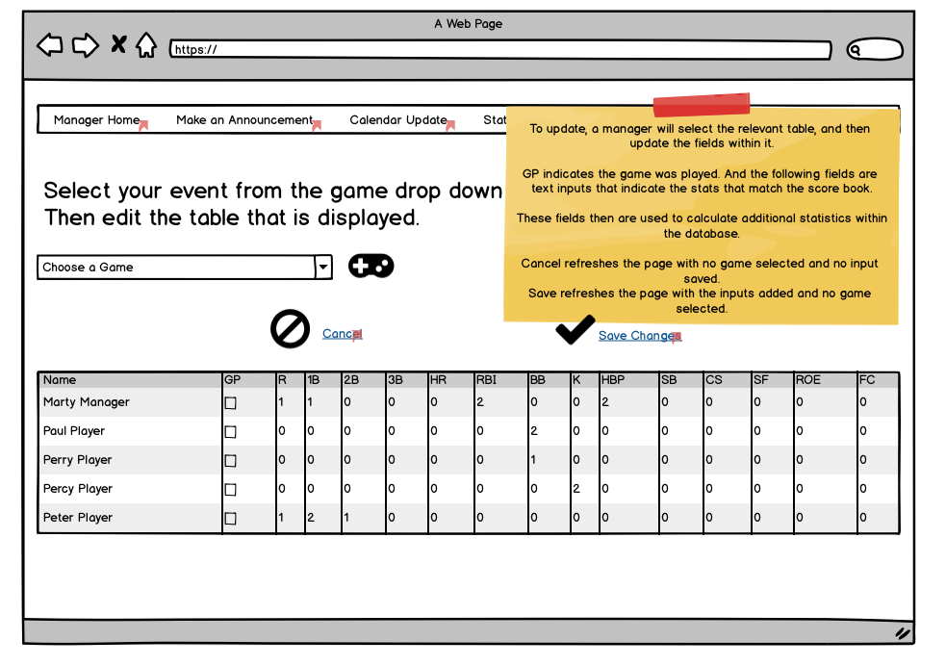
PROBLEM #4 ,5, & 6 – STATS ARE NOT LOCATED IN ONE PLACE | STATS ARE HARD TO COMMUNICATE, COMPARE, AND DISCUSS | STATS ARE ONLY AVAILABLE VIA EMAILED DOCUMENT STORYBOARDS
THE SOLUTION BEGINS BY ALLOWING MANAGER MARTY TO UPDATE ALL INFORMATION IN ONE PLACE

Slide 23
PROBLEM #4 ,5, & 6 – STATS ARE NOT LOCATED IN ONE PLACE | STATS ARE HARD TO COMMUNICATE, COMPARE, AND DISCUSS | STATS ARE ONLY AVAILABLE VIA EMAILED DOCUMENT STORYBOARDS
MOVING TO AN ONLINE DATA MANAGEMENT SYSTEM SOLVES THESE PROBLEMS EASILY AND EFFICIENTILY. IT ALSO EXPANDS THE FUNCTIONALITY FROM BEING A ONE GAME TO ONE SEASON VIEW, TO NOW ADD HISTORICAL CONTEXT AND COMPARISONS.
THIS IS AN IN-DEMAND FEATURE FOR OUR PLAYER PERSONAS.

Slide 24
END

